Slide 1

Crowdsourcing aPP
Supervised by : prof. Ali Abdul Raouf Halawa

Slide 2



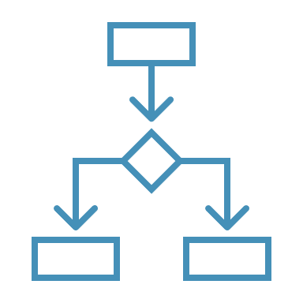

Table of contents
Introduction
Problem statement
User Story
USECASES
app architecture

Slide 3
Introduction
Crowdsourcing is the practice of obtaining services, ideas, or content by involving a large group of people, particularly via the internet. It offers a way to harness the collective intelligence and skills of a diverse group of people to solve problems and complete tasks.

Slide 4
Problem Statement
The Problem :
Many businesses and individuals require specific skills and expertise for their projects, but hiring full-time employees may not be practical or cost-effective. Moreover, talented freelancers often struggle to find quality work and clients that match their skills.
The Solution :
Our freelancing platform, like Upwork, connects clients with freelancers who have the skills they need. Clients can easily find and hire skilled workers, while freelancers can showcase their skills and land quality projects

Slide 5
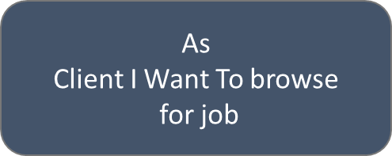
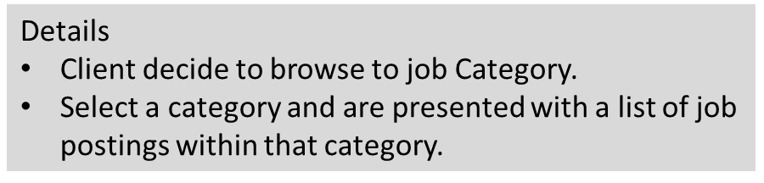
User Story (Client)
As Client I Want Manage My Personal Info
Details
Edit my private Info.
View Personal Info
Update Personal Info.

Slide 6
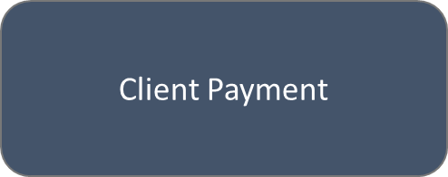
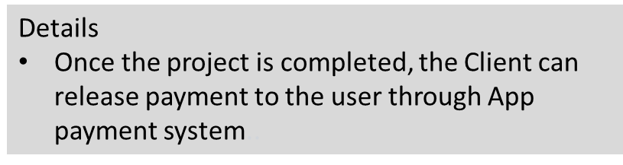
User Story (Client) – cont.
Details
When the user clicks on a job posting
they are taken to the job details page
he job details page includes information such as the job title, job description, required skills, and pay rate.
Manage the Job Posting (Update-Delete-Remove)
Poster cover letter and any other relevant information.
As Client I Want to Job Postings

Slide 7
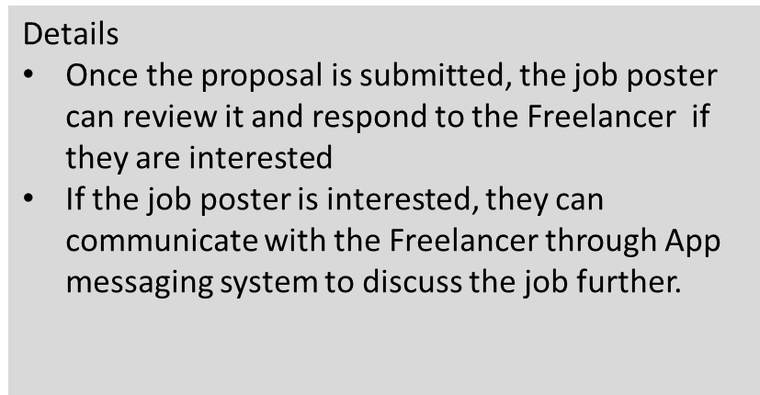
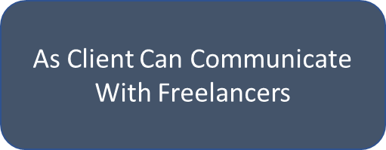
User Story (Client) – cont.
Details
After the project is completed and payment has been released, the Freelancer and Client can leave a review for each other to help build their reputation on the platform.
Review

Slide 8
User Story (Freelancer)
Details
Signup , login page
provide their full name, email address, and a strong password to create their account.
add a profile picture, a short bio, and select the type of services they offer
add their education and work experience, along with any certifications or awards they have received.
add a portfolio of their past work to showcase their skills and expertise.
As a freelancer, I want to create an account and fill out my profile with relevant information
Details
can browse projects by categories such as web development, graphic design, writing, etc.
The freelancer can filter the project search results by various criteria such as project type, budget range, project duration, etc.
As a freelancer, I want to Browse and search for projects matching skills and interests

Slide 9
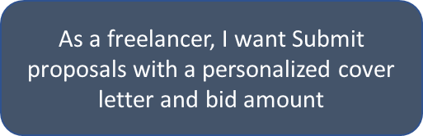
User Story (Freelancer) – cont.
DetailsThe freelancer can ask clarifying questions about the project requirements, timeline, and budget, as well as provide updates on their progress.
Once the freelancer finds a project that matches their skills and interests, they can submit a proposal.
The proposal should include a personalized cover letter that explains why the freelancer is the best fit for the project and what they can offer.
The freelancer should also include a bid amount that they are willing to work for.
The freelancer can choose to include any additional details or attachments that they feel are relevant to their proposal.

Slide 10
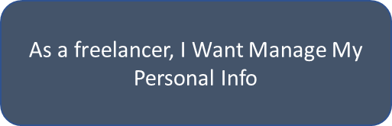
User Story (Freelancer) – cont.
Details
After a freelancer has submitted a proposal and it has been accepted by the client, they can communicate through comments on the request or direct chat..
The chat feature will include text and file sharing capabilities, allowing the freelancer to send project deliverables or ask for feedback on their work.
The chat feature will also include notifications to ensure that the freelancer is aware of any new messages or updates from the client.
As a freelancer, I want to communicate with the client
Details
Edit my private Info.
View Personal Info
Update Personal Info.

Slide 11
User flow
Sign as Freelancer
Role
Create an Account
Sign as Client
No
Has An Account
Loged in
Login Page
Yes
Login

Slide 12

Use cases - Freelancer
Register
Log in
Accept Request
Service Request
Reject Request
Freelancer
Chat With Users
Feedback

Slide 13


Use cases - client
Register
Log in
Add Service
Service Manage
Remove Service
Client
Chat With
Update Service
Notifications
Freelancer

Slide 14

Use cases - Admin
Login
Add-Remove Users
Admin
Manage Website
Remove Service
See All Requests

Slide 15
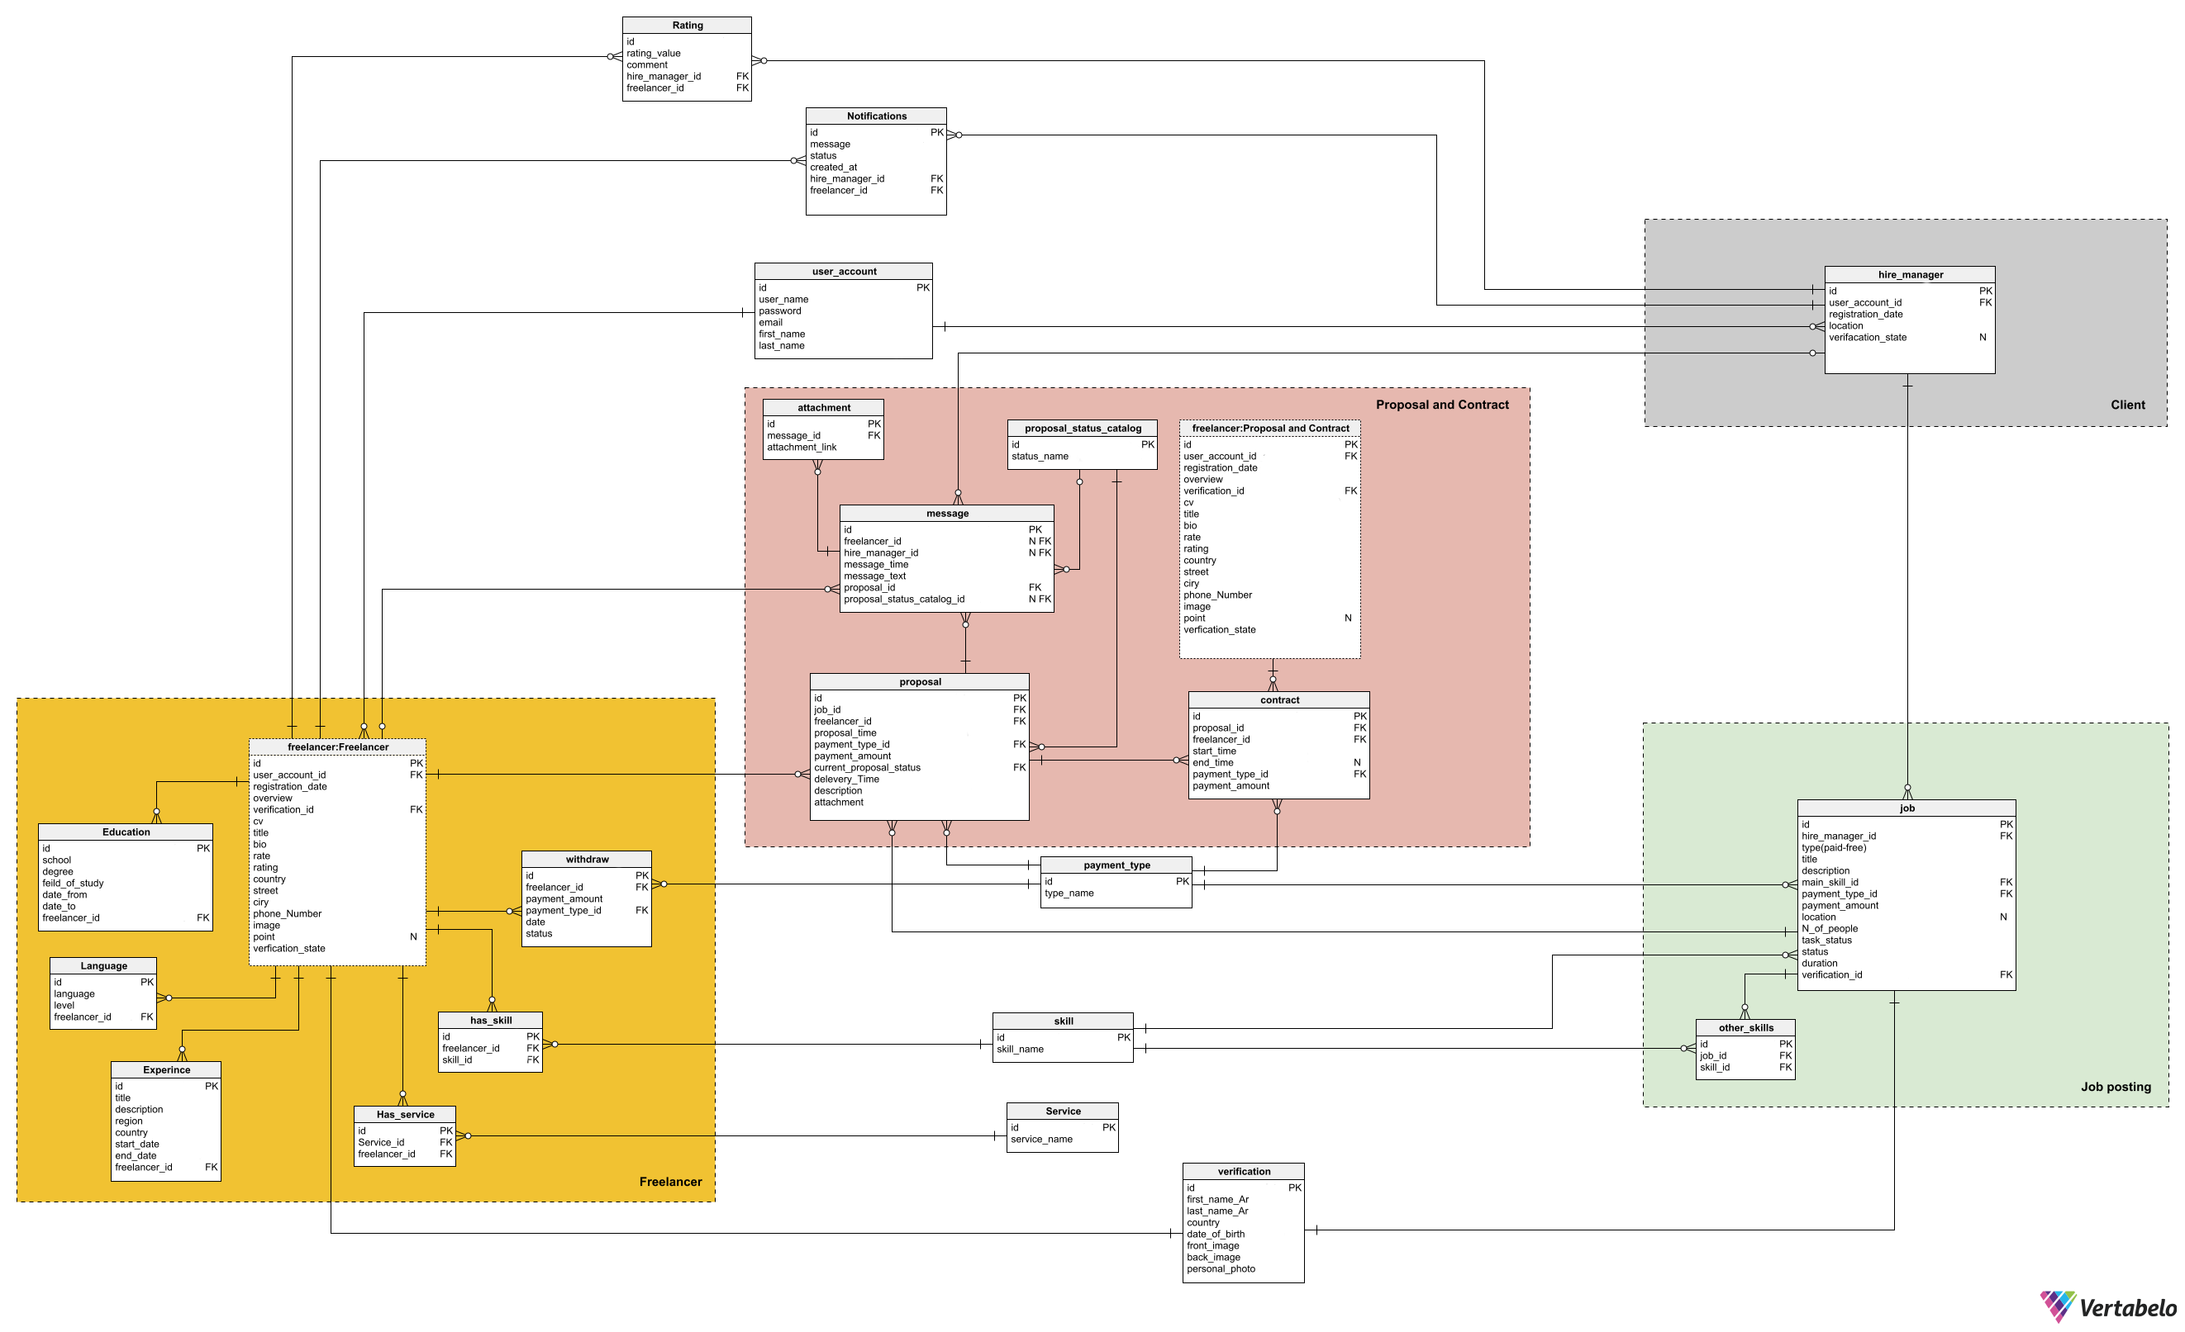
Er Diagram

Slide 16
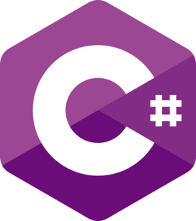



Java Script
C#
DART
SQL
PROGRAMMING LANGUAGES

Slide 17




Technologies
React JS
Asp .Net
Sql Server
Flutter

Slide 18
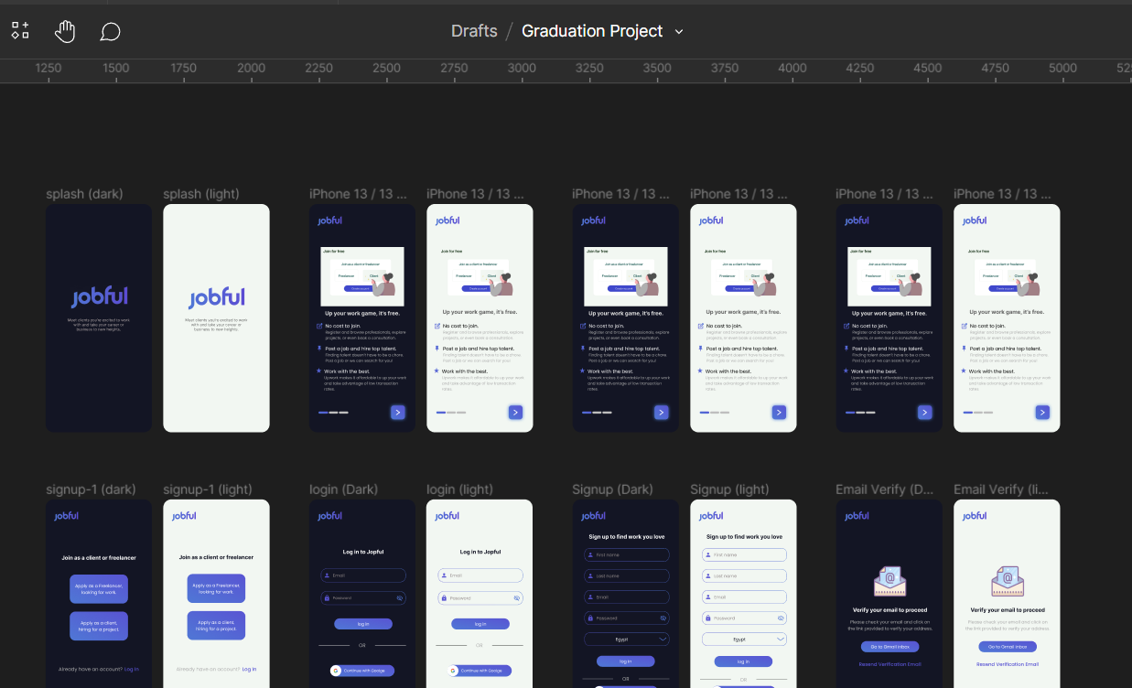
UI - mOBILE
Figma : click here 🔗

Slide 19
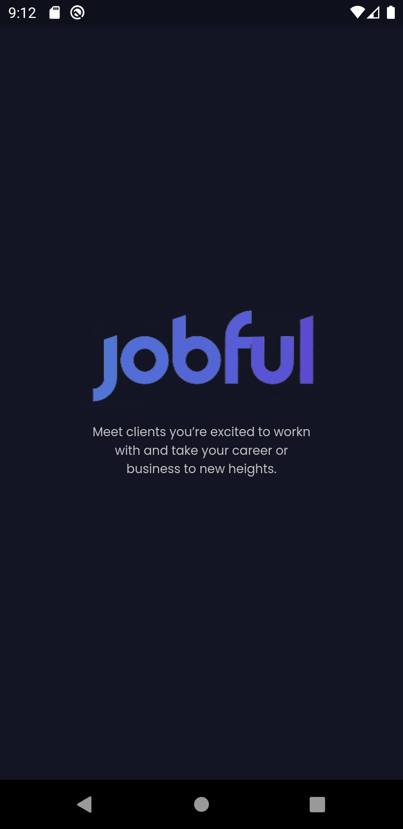
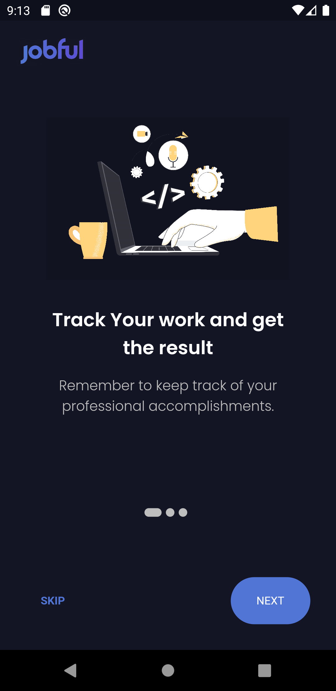
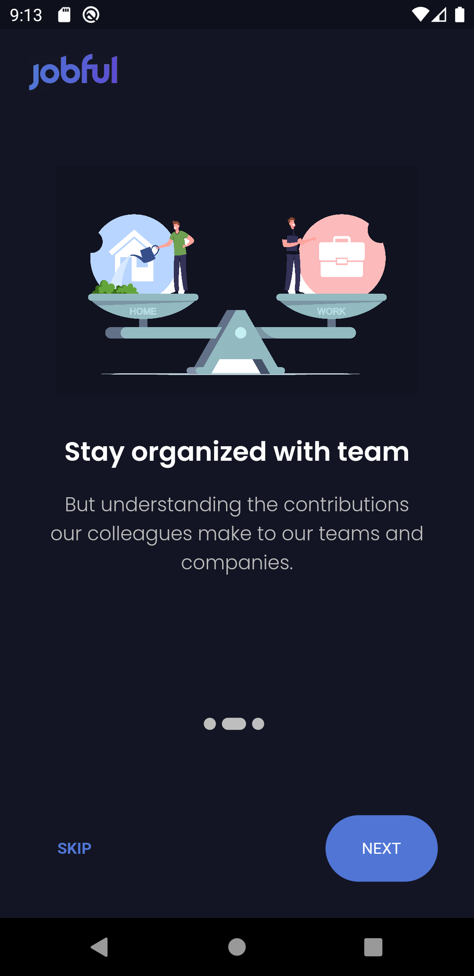
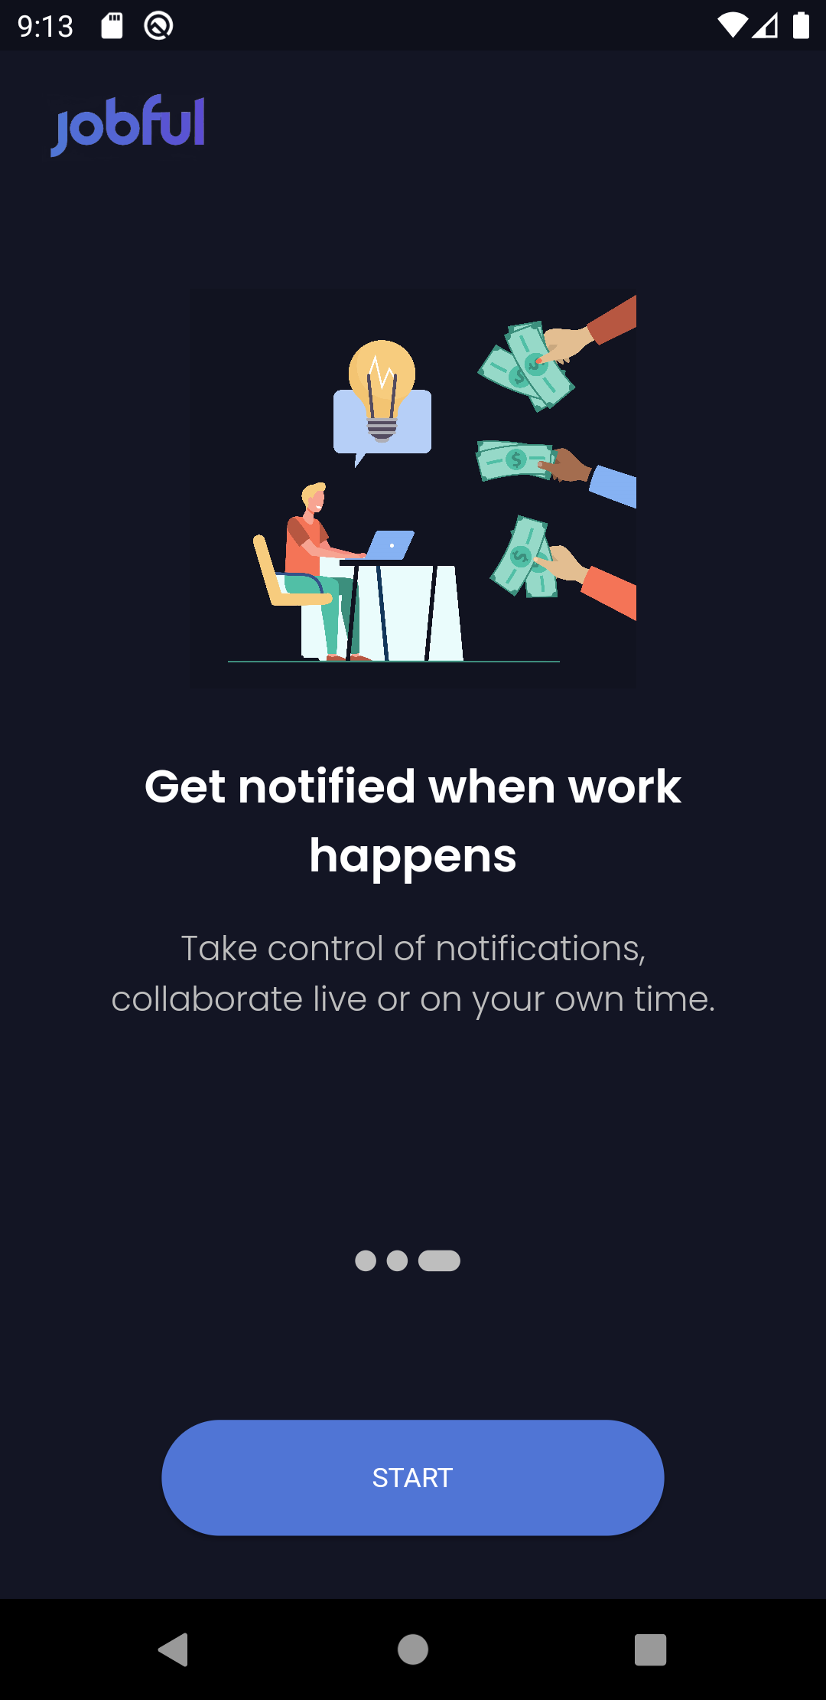
UI - mOBILE
Splash View
Onboarding View

Slide 20
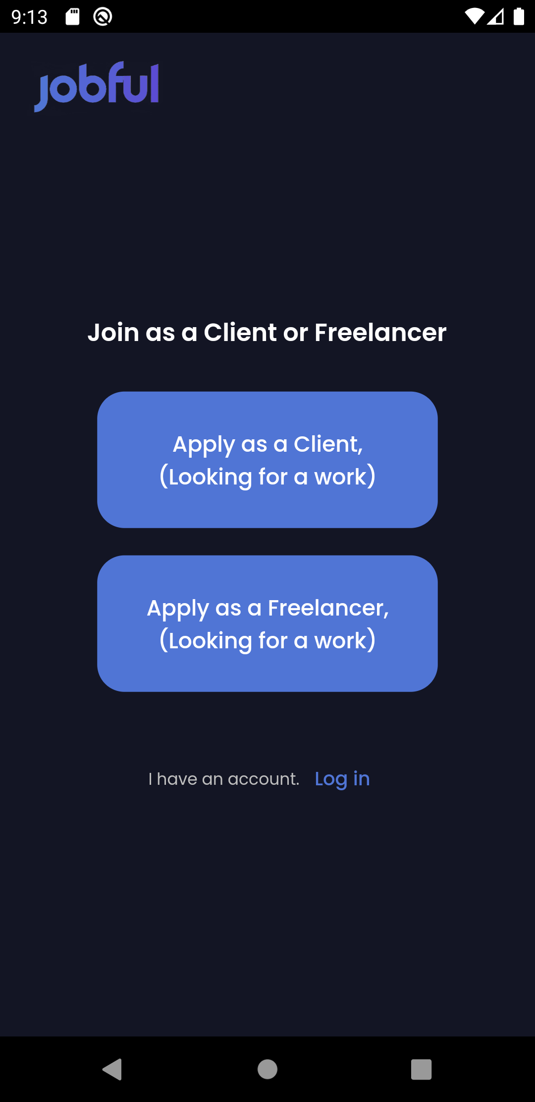
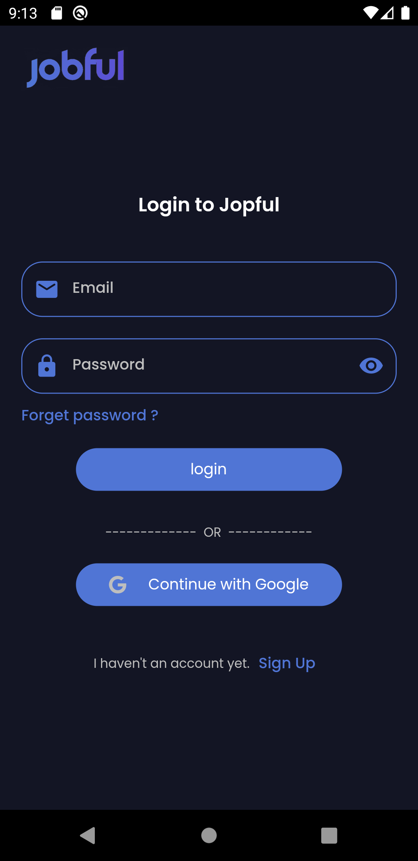
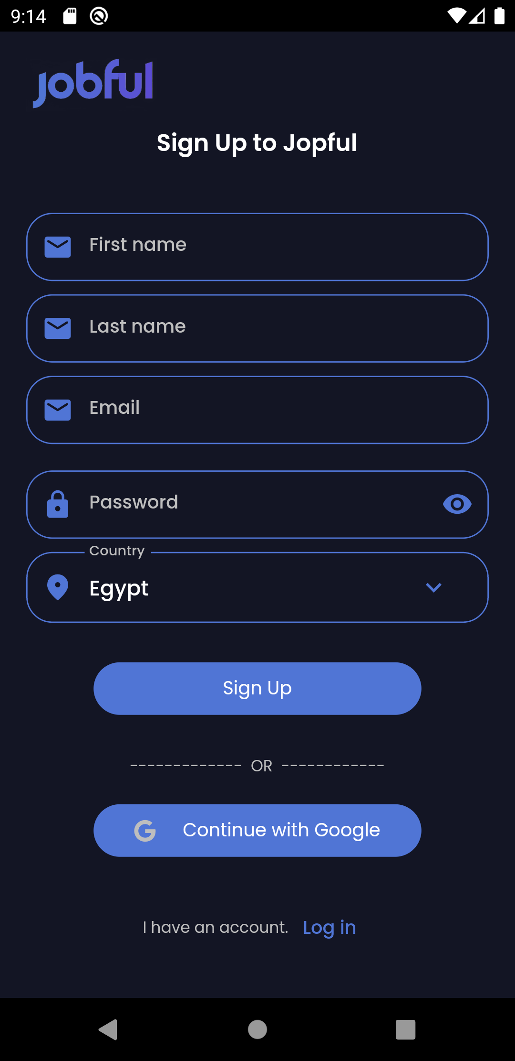
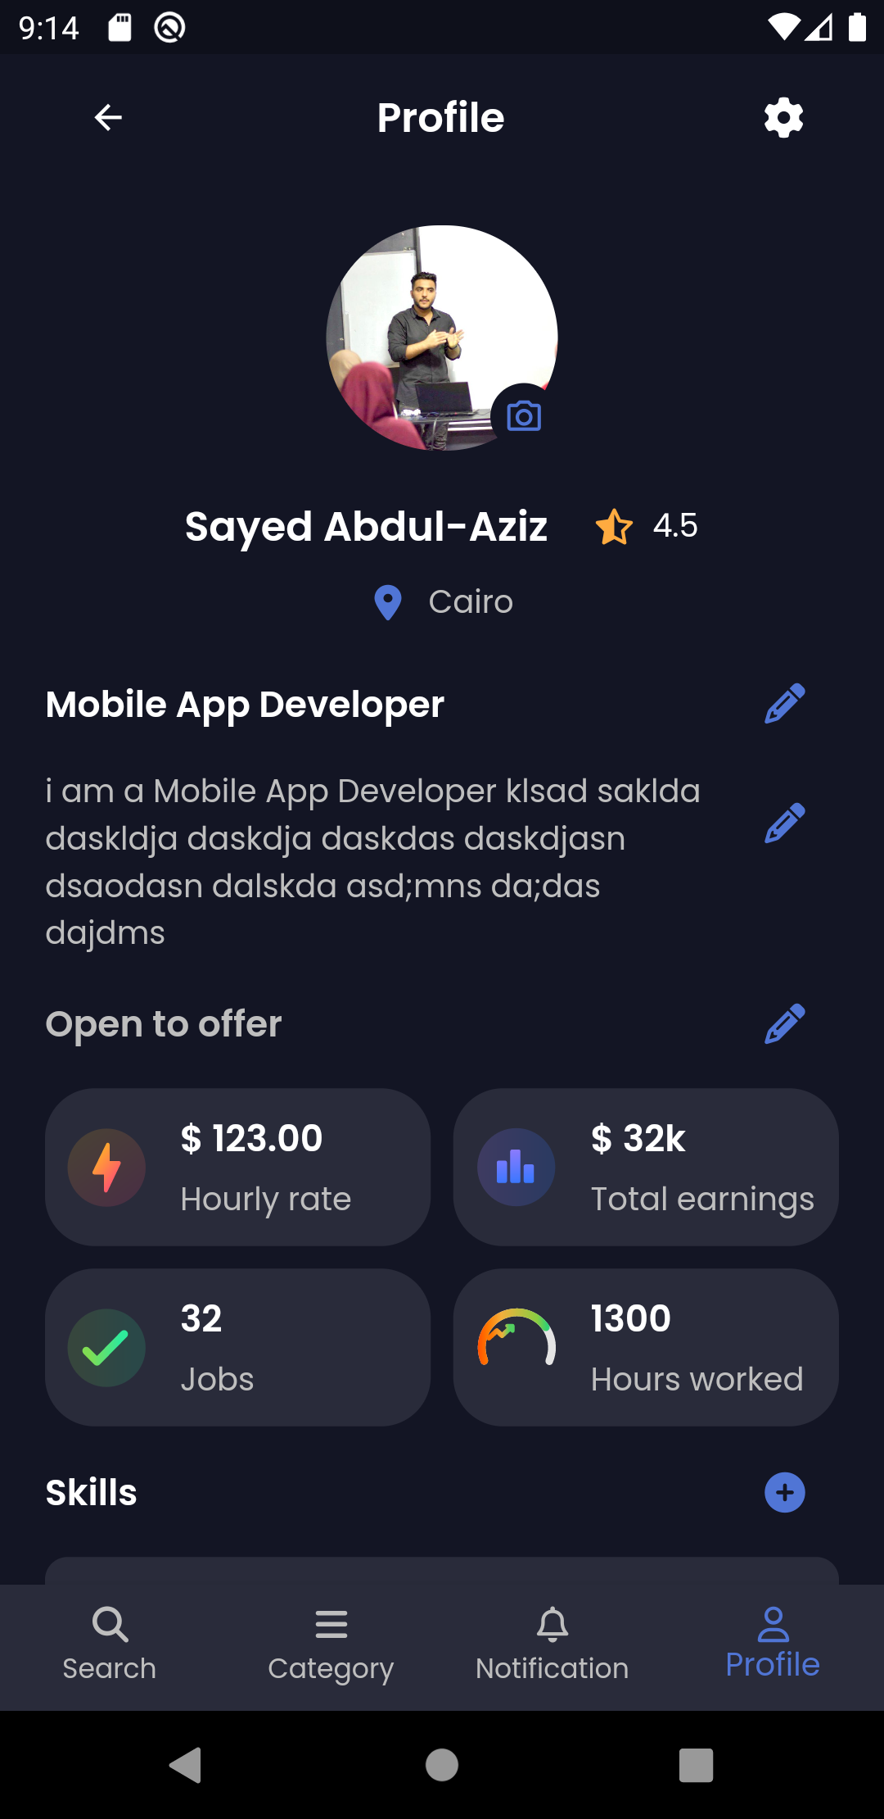
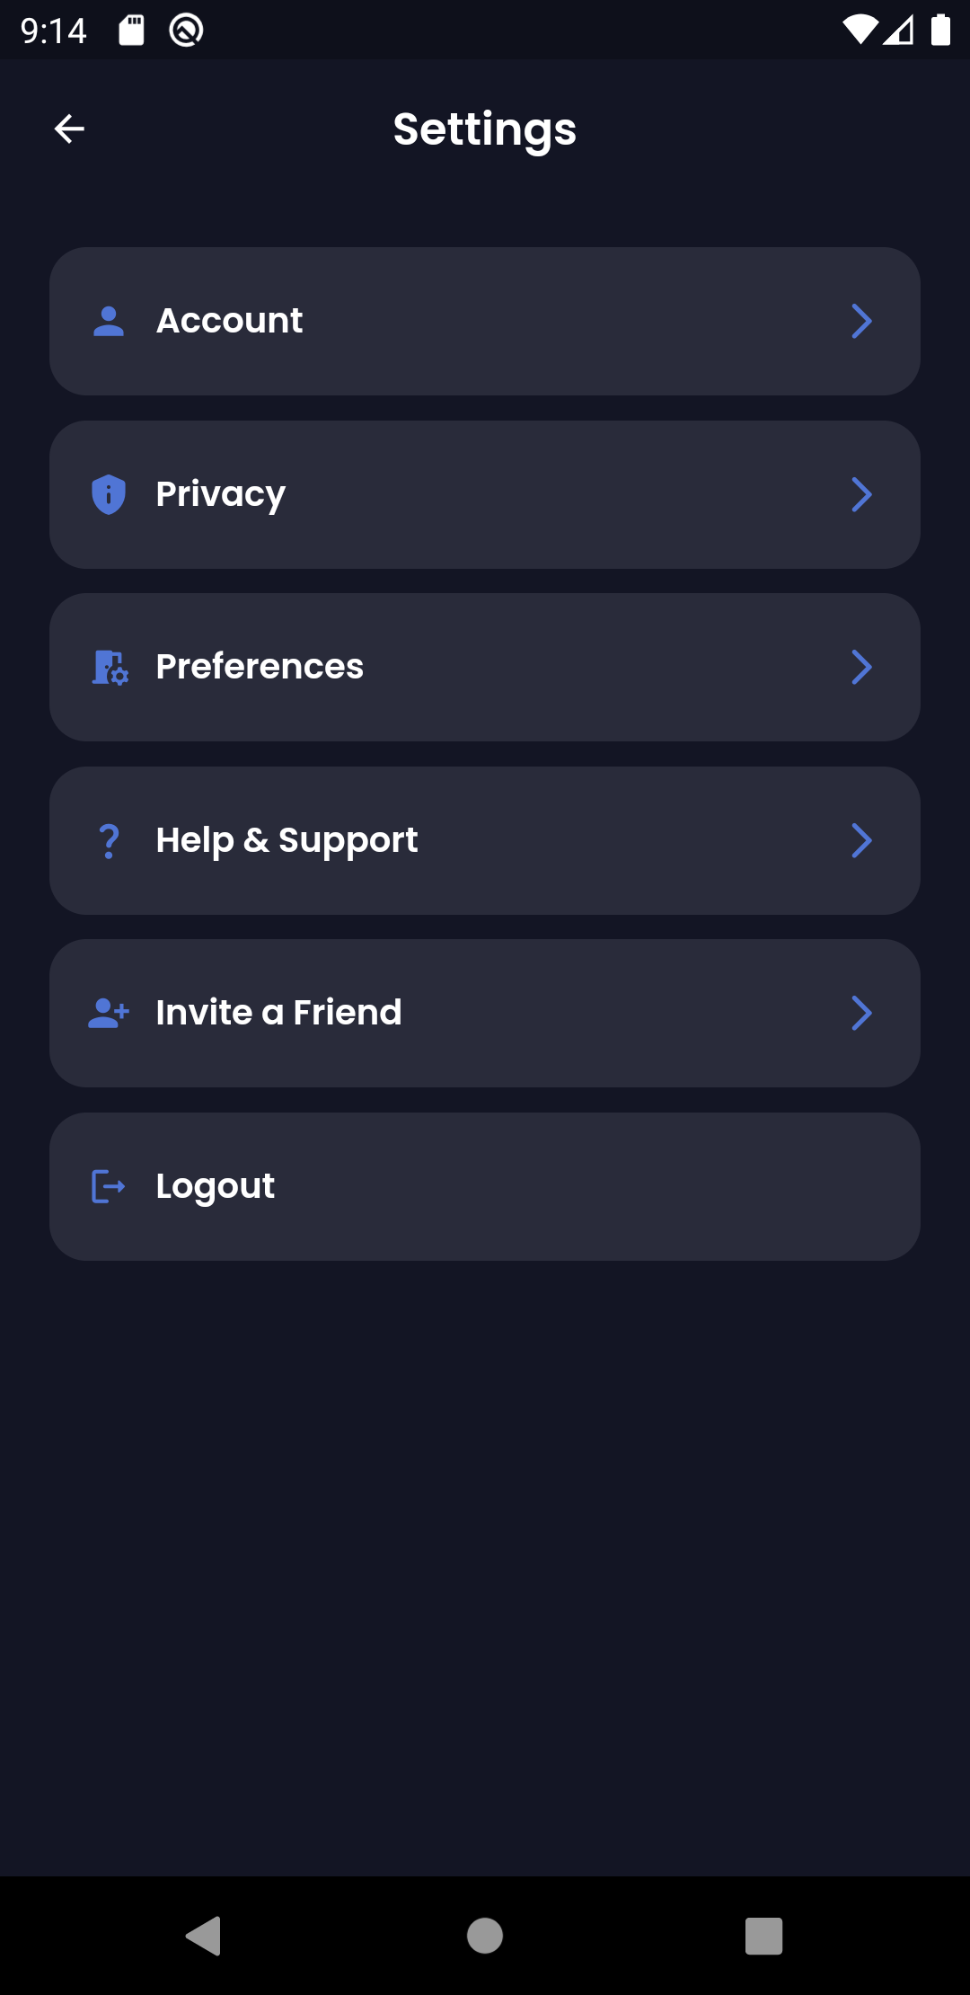
UI - mOBILE
Role View
Login View
Signup View
Profile View
Settings View

Slide 21
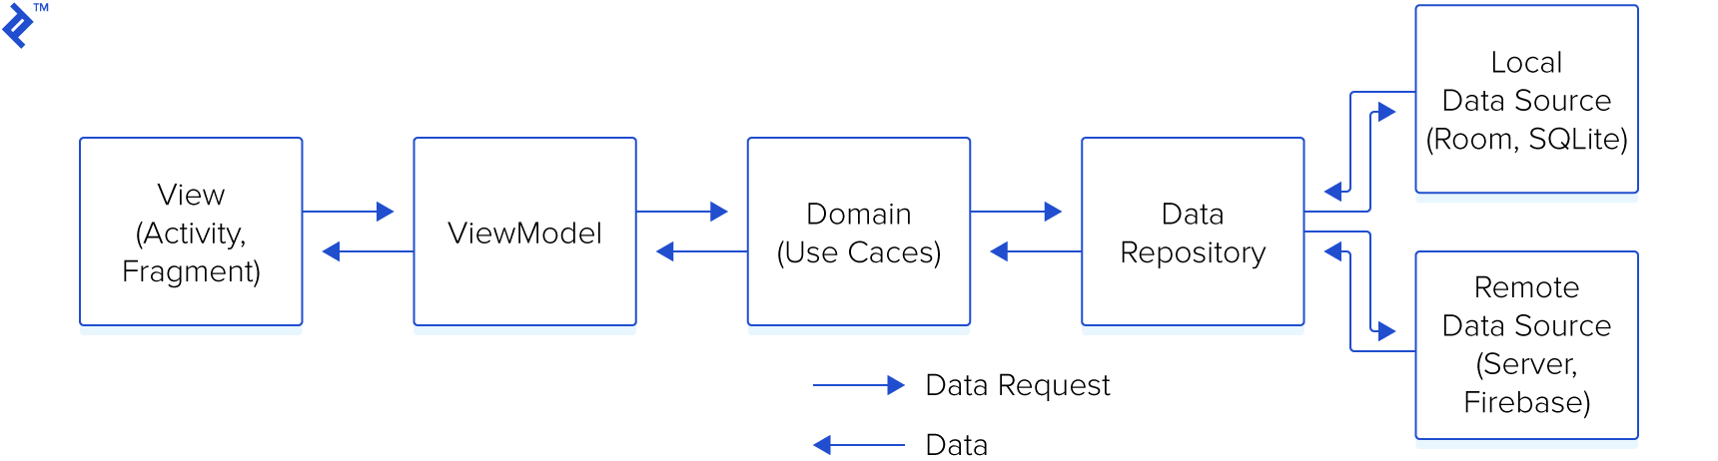
MVVM Architecture
Model–View–ViewModel (MVVM) is a very established architectural pattern when it's come to software development.
There are 3 main modules to help separate the code. They are Data, Domain, and Application.

Slide 22
External Packages
dio : allows data to be saved asynchronously persistently on iOS and Android devices.
Shared_prefeneces : allow you to save and retrieve data in the form of key,value pair in IOS and Android.
flutter_bloc: is a simple, predictable, and easily testable solution to state management .
url_launcher: is a convenient way to launch external URLs from your application with many URL schemes supported
easy_localization: It does more than support language translations; it also supports text direction, and more.

Slide 23
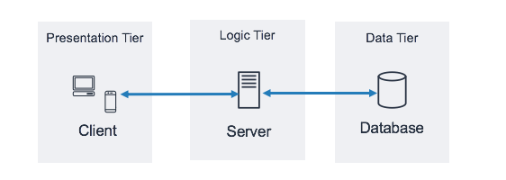
Three-tier architecture
Three-tier architecture is a well-established software application architecture that organizes applications into three logical and physical computing tiers: the presentation tier, the data tier and the application tier.

Slide 24
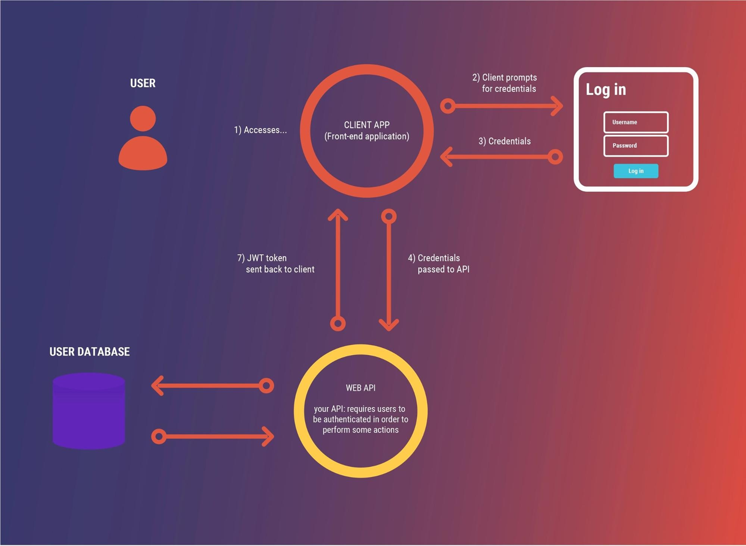
JSON Web Token (JWT)
JSON Web Token (JWT) is an open standard (RFC 7519) that defines a compact and self-contained way for securely transmitting information between parties as a JSON object.
This information can be verified and trusted because it is digitally signed.
JWTs can be signed using a secret (with the HMAC algorithm) or a public/private key pair using RSA or ECDSA.

Slide 25


Web API
ASP .Net Core Web API :
- ASP.NET Core is a cross-platform, high-performance, open-source framework for building modern, cloud-enabled, Internet-connected apps.
- ASP.NET Core supports creating web APIs using controllers or using minimal APIs. Controllers in a web API are classes that derive from ControllerBase.
Swagger
Swagger (OpenAPI) is a language-agnostic specification for describing REST APIs. It allows both computers and humans to understand the capabilities of a REST API without direct access to the source code. Its main goals are to:
Minimize the amount of work needed to connect decoupled services.
Reduce the amount of time needed to accurately document a service.

Slide 26
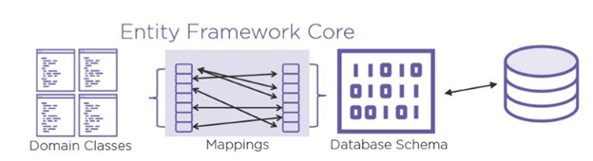
Entity Framework (EF) Core
Entity Framework (EF) Core is a lightweight, extensible, open source and cross-platform version of the popular Entity Framework data access technology.
EF Core can serve as an object-relational mapper (O/RM), which:
Enables .NET developers to work with a database using .NET objects.
Eliminates the need for most of the data-access code that typically needs to be written.
EF Core supports many database engines,
The model
With EF Core, data access is performed using a model. A model is made up of entity classes and a context object that represents a session with the database.
The context object allows querying and saving data.
Querying
Instances of your entity classes are retrieved from the database using Language Integrated Query (LINQ). Saving data
Data is created, deleted, and modified in the database using instances of your entity classes

Slide 27

Thank You

